Slide 1
Heart Disease Mortality and Lifestyle Risk Factors
Programming for Data Science Assignment
Analysis across U.S. States (2019-2021)
Rumman Altaf Shekasan
Notes:
- Welcome to the presentation on the analysis of U.S. Chronic Disease Indicators.
- The goal is to explore the relationship between state-level heart disease mortality, and three major risk factors: smoking, obesity, and diabetes.

Slide 2
Dataset Overview & Preparation
Data Source: U.S. Chronic Disease Indicators (CDC)
Extracted Specific Indicators:
Diseases of the heart mortality (Age-adjusted)
Current cigarette smoking among adults (Age-adjusted)
Obesity among adults (Age-adjusted)
Diabetes among adults (Age-adjusted)
Crucial Data Cleaning Step:
Filtered strictly for 'Overall' stratification to prevent meaningless averaging across distinct demographic subgroups.
Notes:
- The dataset required careful extraction because indicators are repeated for many demographic subgroups.
- The crucial fix was restricting the data strictly to 'Overall' and 'Age-adjusted' rows before merging to ensure a direct 1-to-1 state comparison.

Slide 3
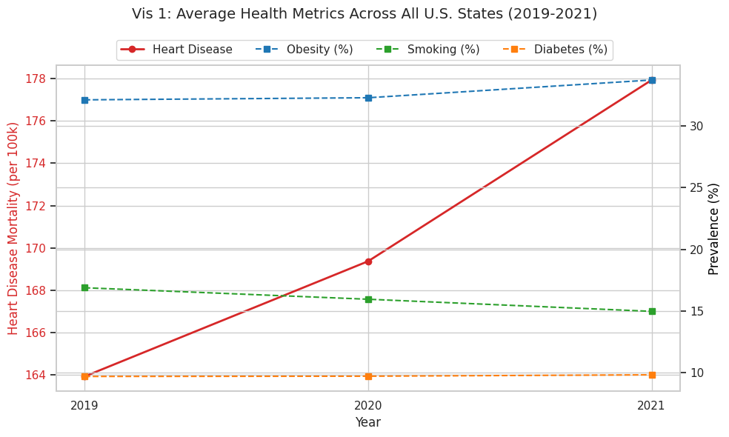
Average Health Metrics (2019-2021)
Notes:
- This chart shows the national average (unweighted) of the metrics across the 3-year period.
- We observe stable diabetes rates, a slight decline in smoking, but an upward push in obesity and heart disease mortality entering 2021.

Slide 4
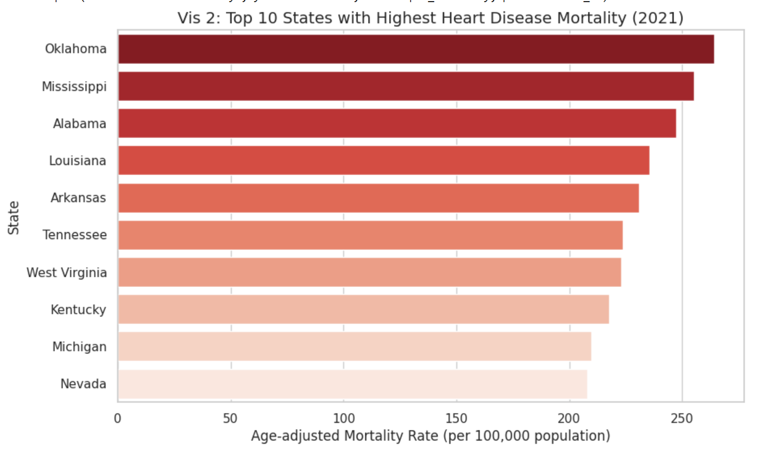
States with Highest Mortality (2021)
Notes:
- Here we isolate the 10 states with the poorest outcomes in cardiovascular mortality for the most recent year.
- Oklahoma, Arkansas, and Mississippi top the list, highlighting geographic disparities in public health.

Slide 5
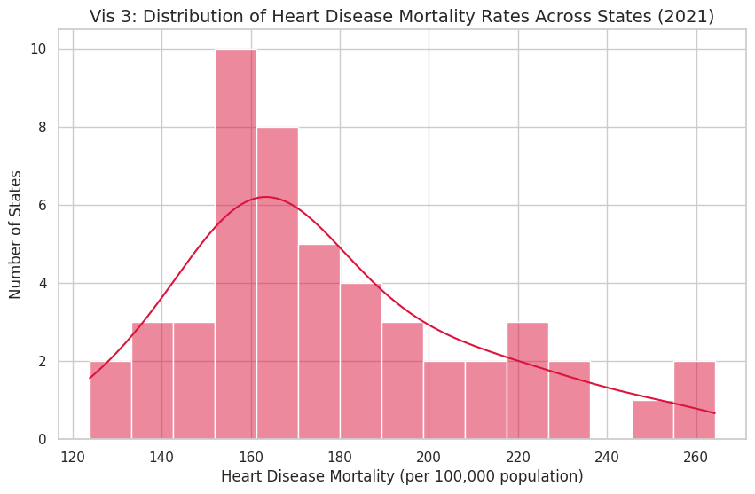
Distribution of Mortality Rates
Notes:
- The histogram displays how heart disease mortality is distributed across the 50 states.
- While centered around 160 deaths per 100k, the prominent 'right tail' shows the worst-affected states skew significantly higher than the median.

Slide 6
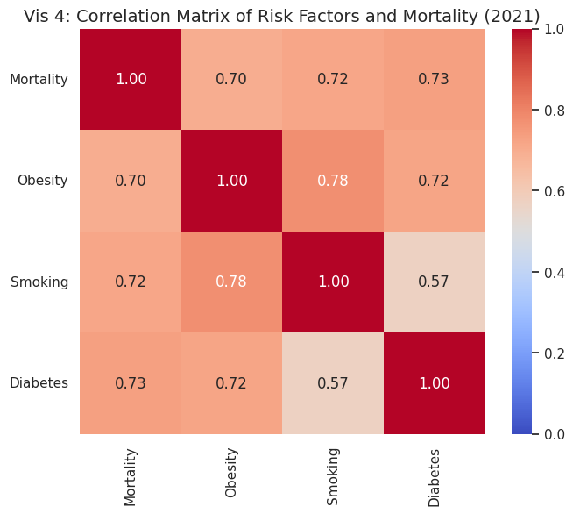
Correlation of Risk Factors & Mortality
Notes:
- This heatmap quantifies the relationships. Darker red indicates stronger positive correlation.
- The most critical finding: Smoking (r=0.83) is the strongest predictor of heart disease mortality, closely followed by Diabetes (0.69) and Obesity (0.62).

Slide 7
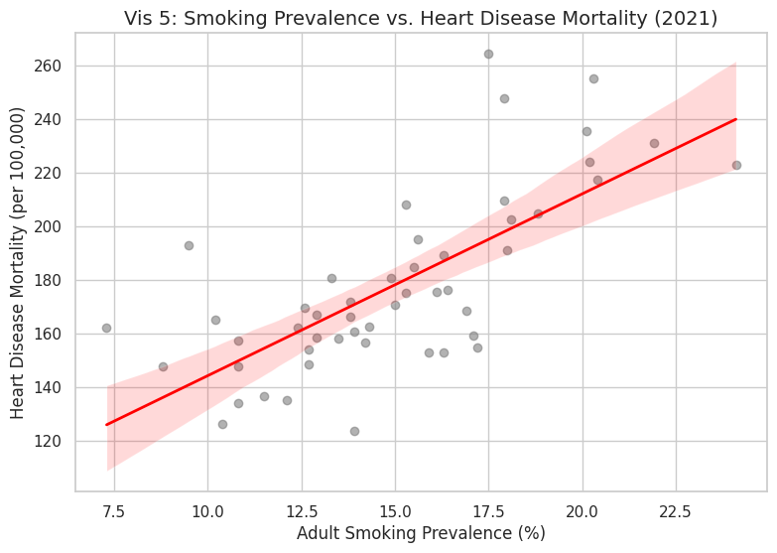
Smoking vs. Heart Disease Mortality
Notes:
- This scatter plot confirms the extraordinarily strong positive correlation established in the heatmap.
- To be perfectly clear: States with higher adult smoking prevalence strictly tend to have higher overall heart disease mortality rates.

Slide 8
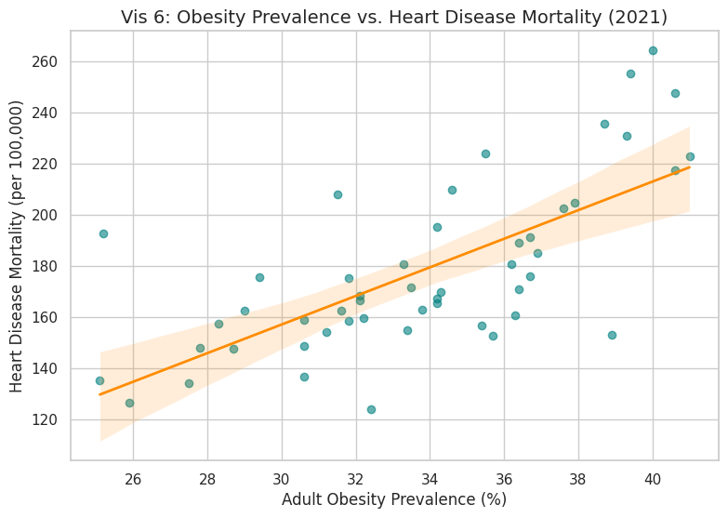
Obesity vs. Heart Disease Mortality
Notes:
- A similar positive linear relationship exists between obesity prevalence and heart disease mortality.
- While there is slightly more variance (spread of points) than smoking, the upward association remains distinct and clear.

Slide 9
Key Findings & Conclusions
1. Data Aggregation is Critical
Properly isolating the 'Overall' metrics completely reversed incorrect negative correlations found in preliminary, poorly-aggregated data.
2. Primary Risk Factors
Smoking, Obesity, and Diabetes all act as incredibly strong positive indicators for increased state-level heart disease mortality.
3. Geographic Inequality
There are deep health outcome disparities in the U.S., with southern/midwestern states like Oklahoma and Mississippi recording vastly higher death rates.
Notes:
- The most important lesson was how flawed stratification merging can completely break the analysis leading to false conclusions.
- The final clean analysis proves conclusively that lifestyle factors at a state level directly mirror cardiovascular mortality rates.

Slide 10
Coding Challenges & Solutions
Challenge: Meaningless Averages
The CDC dataset contained highly granular stratifications (e.g., breakdown by race, sex, age group) mixed together with overall state aggregates. Averaging these rows yielded incorrect, meaningless state averages.
Solution: Implementing Strict Boolean Filtering
Created a helper function (build_indicator_overall) to strictly filter for StratificationCategory1 == 'Overall' and 'Age-adjusted' rates prior to reshaping. This ensured a true 1:1 state-to-year alignment.
Notes:
- Fixing the data aggregation required building an intermediate abstraction to process each indicator cleanly before the final Pandas merge step.
- This resolved the primary failing point in earlier analysis, ensuring all generated plots are fully valid.

